Slide 1
Ball Balancing Using pid control
Under the supervision of Dr. Satish Dhandole
Submitted by-
Vrishabh Kenkre
Divesh Shet

Slide 2
Project Originality
This is to certify that to the best of my knowledge; the content and idea of this project are our own work. This work has not been submitted for any course or any other purposes.
We certify that the intellectual content of this project is the product of our own work.

Slide 3
Introduction
The goal of this project is to build high performance control system by making use of low cost equipment.
We implemented proportional-integral-derivative (PID) controller to balance a ball at the center of a beam.
The purpose of the project was to build a platform that will allow a user to balance a ball on the centre of the beam.
Using an Arduino Uno along with a DC brushed motor and various electrical components, the platform was constructed on a cardboard beam.

Slide 4
Control system
A control system is a device that manages and regulates the behavior of a particular system.
The system in our case is the ball balance beam. In this system, a beam must be able to balance a ball and return the ball to the center of the beam if moved.
There are two different types of systems, open loop and closed loop. Open loop systems have no feedback and are simply based on the input while closed loop systems use feedback to improve the control of the system

Slide 5
Pid controller
The PID controller is a type of feedback controller where P stands for proportional, I for integral, and D for derivative.
The “P” term is responsible for producing an output value that is proportional to the current error that the system is calculating.
The “I” term is essentially the sum of all the instantaneous error and is responsible for eliminating the steady state error that the P controller would produce.
The “D” term is responsible for predicting the future system behavior and using the predicted behavior to improve the time and stability of the system.

Slide 6
How our system model is different
Most of the ball beam balancing comprises of one side of beam connected by a steel wire which is then connected to a servo motor. The angle rotated by motor depends on the response given by the sensor.
But we modified the system and connected a blower setup on one end. Now, according to response given by ultrasonic sensor, the voltage across to the motor varies and hence the speed changes.
As the speed changes, the static pressure exerted by the blower on the ball changes and tries to balance the frictional as well as gravitational forces.

Slide 7

System modelling
In this system, the equations of motion can be used to solve for the relationship between the angle of the beam and the ball movement. The equations of motion can be developed into the following form
From this equation, it is possible to solve for M and for theta.

Slide 8
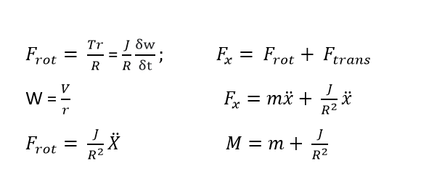
System modelling
Once this relationship is developed, it is possible to code, model, and predict the position of the ball based on the angle of the beam. The next step in the system modeling is to solve for M.

Slide 9
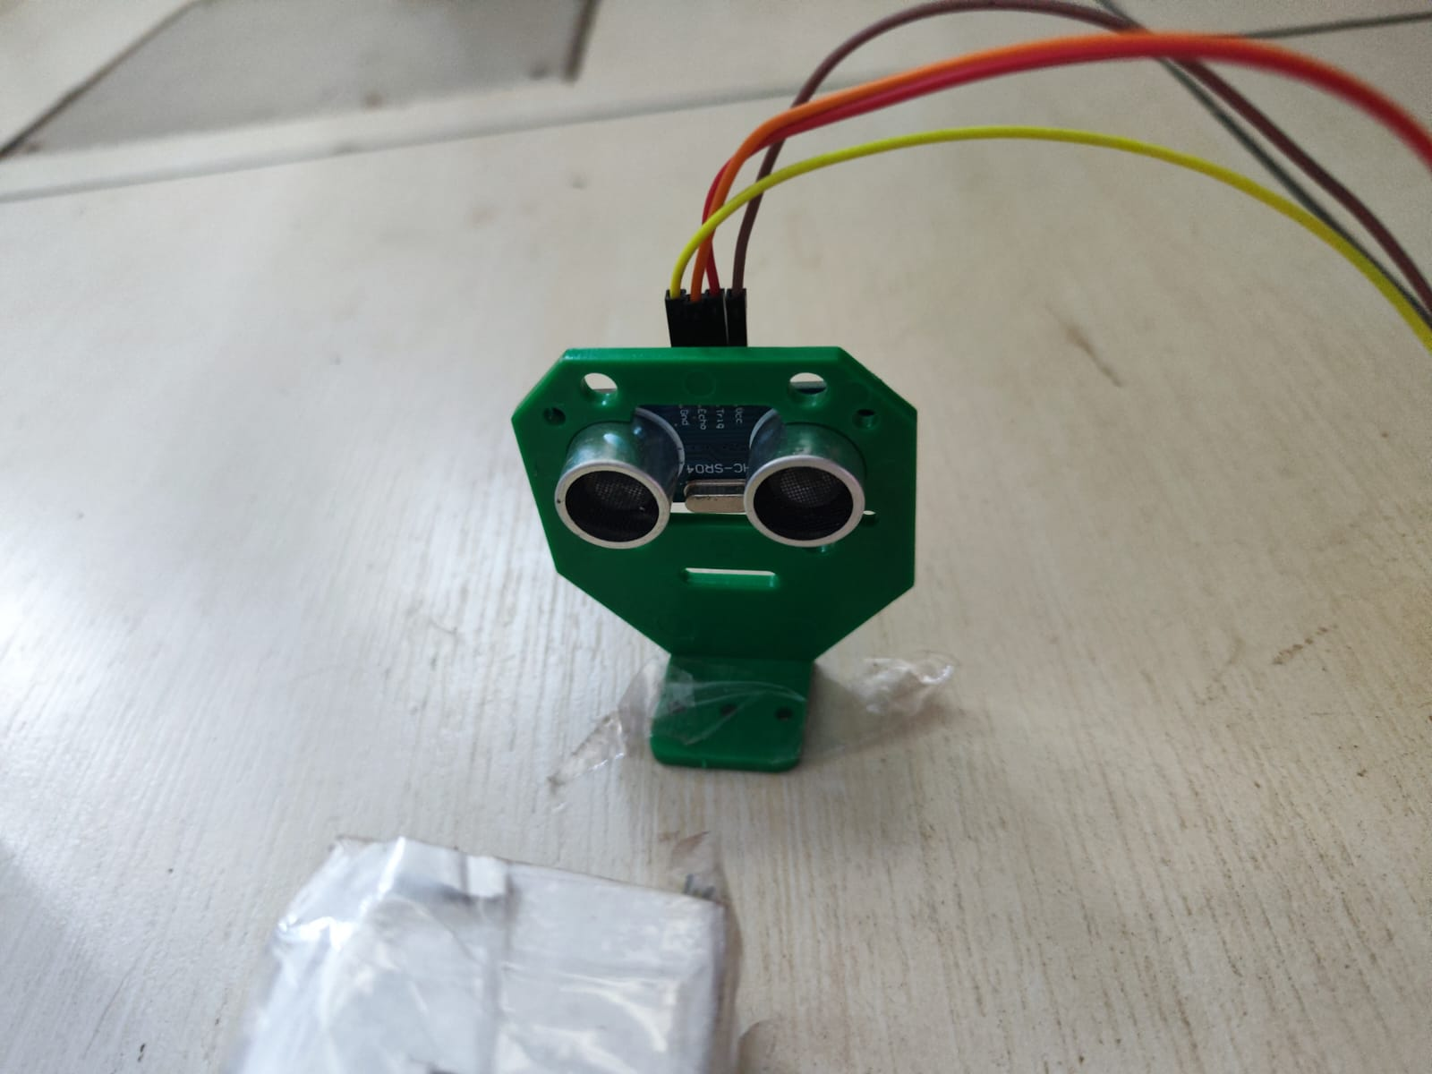
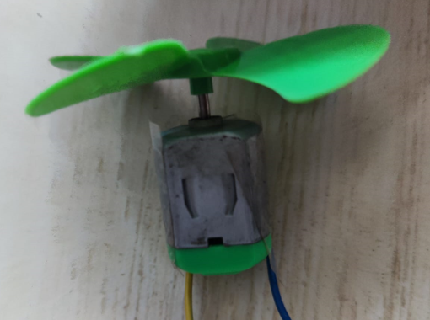
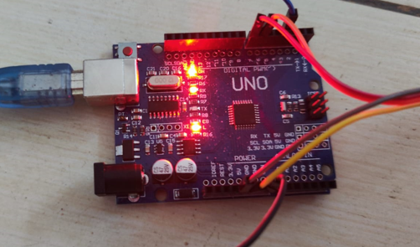
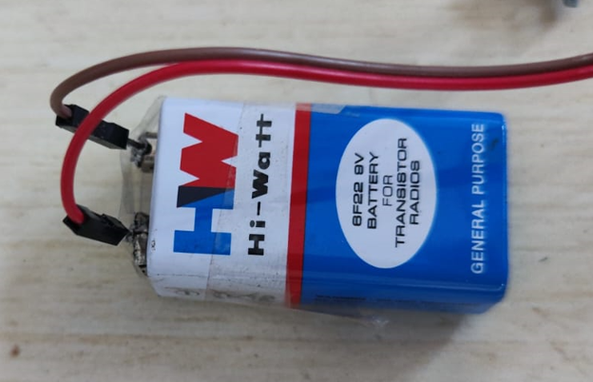
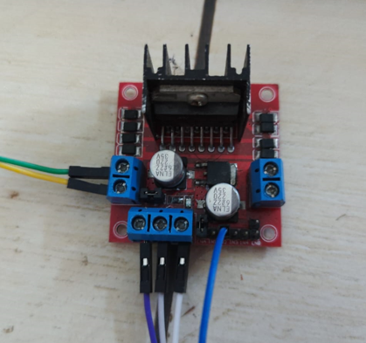
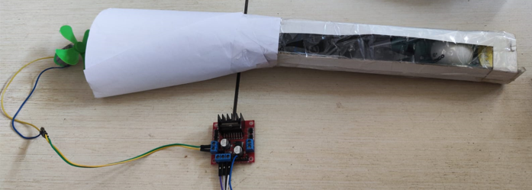
Hardware components
Ultra-sound (sensor setup)
Propeller + DC Motor (actuator)
Arduino Uno (Micro-controller)
Battery 9V
L298N Motor Driver
Blower setup constructed using DC Motor, Propeller, TT ball and Motor Driver

Slide 10
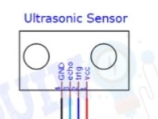


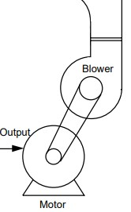
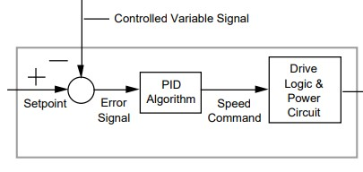
Hardware components Schematic
Ball

Slide 11
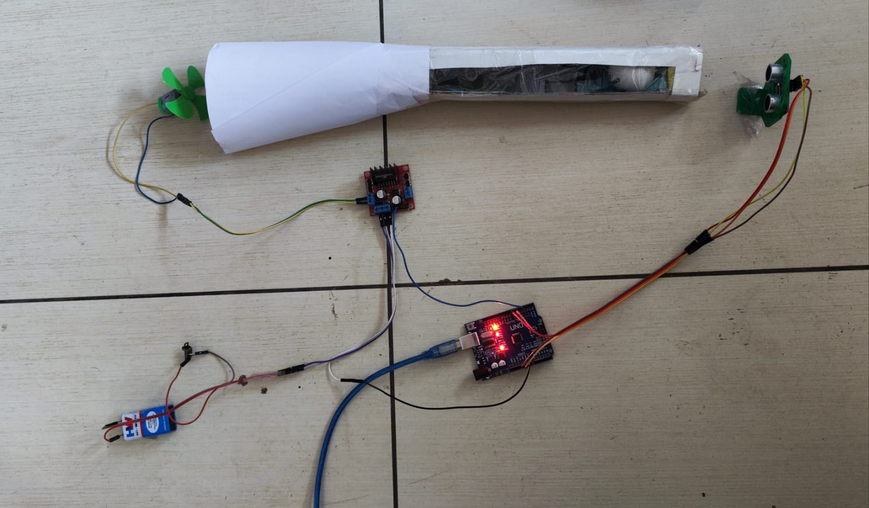
Circuit design

Slide 12
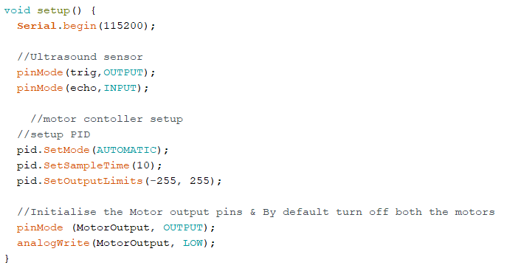
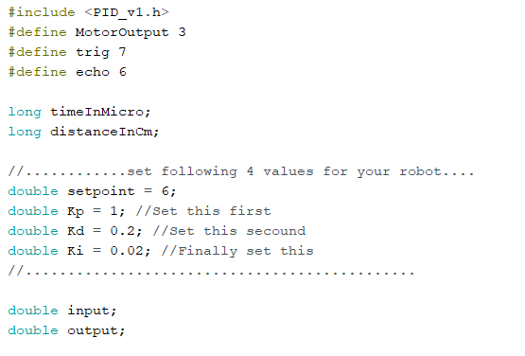
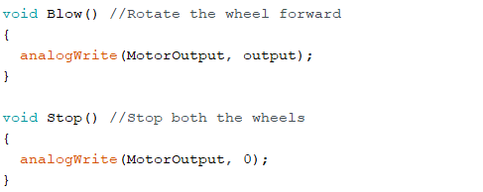
Software design

Slide 13
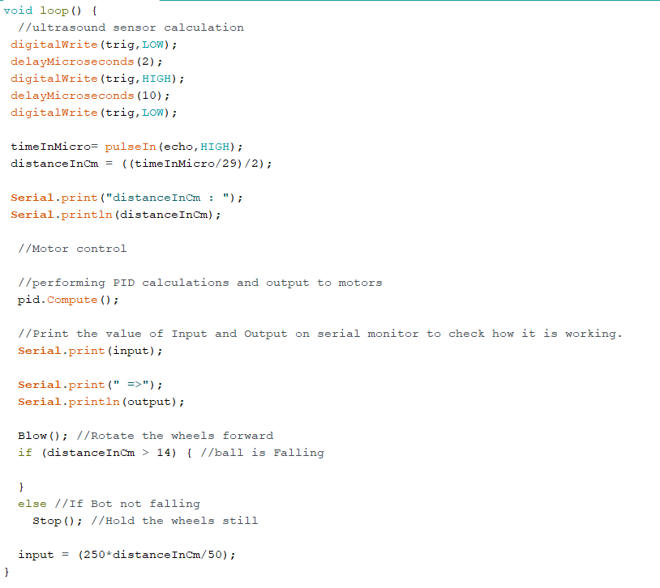
Software design

Slide 14
challenges
As the DC motor’s speed reduces drastically because the brushes were worn down. The system oscillated and this disrupted its equilibrium by a large margin.
The duct made from cardboard did not have uniform cross section. Hence pressure loss increased as enough pressure didn’t build up on the ball.
  To resolve this, cardboard duct dimensions were changed to appropriate size iteratively such that sufficient pressure was able to generate to push the ball and at the same time ball was able to slide smoothly across the length of the duct.

Slide 15
challenges
Ultrasonic sensors use electrical energy and a ceramic transducer to emit and receive mechanical energy in the form of sound waves. Sound waves are essentially pressure waves that travel through solids, liquids and gases. So because of pressure fluctuations from blowers, they disrupt the signal of the sensor.

Slide 16
Thank you

